Slide 1
Human Centered Engineering Design
Spring 2020
ME 170

Slide 2
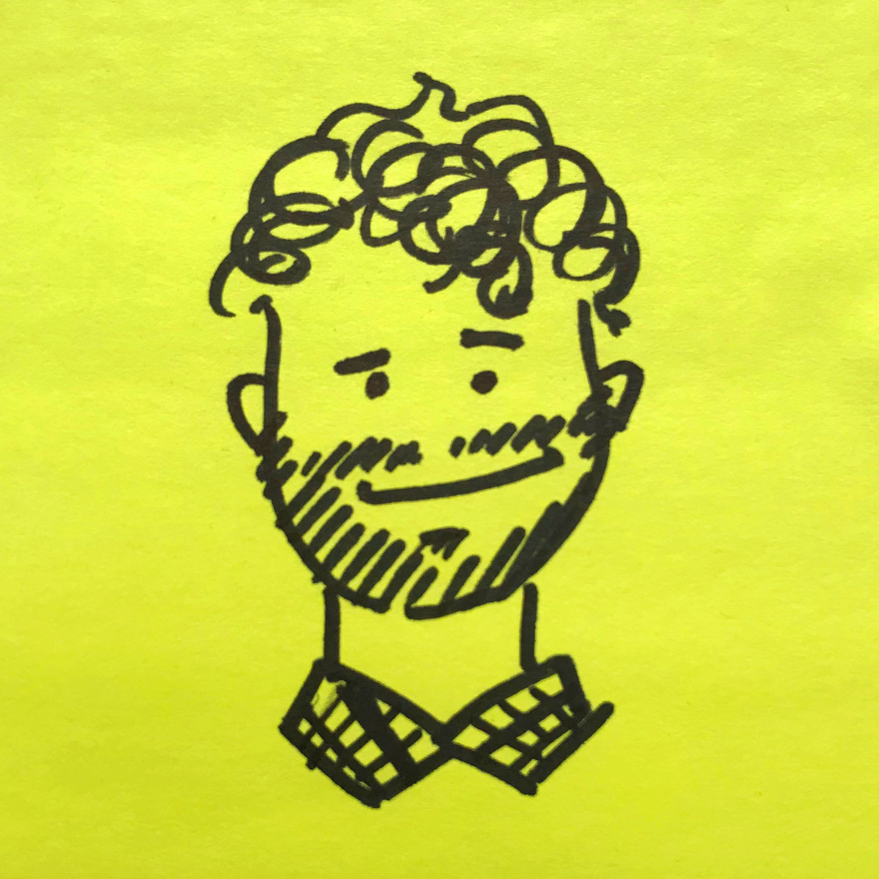
Coming Fall 2020!
Alex Pagano
Senior Design Strategist
apagano2@illinois.edu

Slide 3
Learning Objectives
At the end of this lecture you should be able to…
Define human centered design
Summarize why engineers should practice human centered design
Explain how human centered design fits into this course and beyond

Slide 4
Wait isn’t this a CAD class?
Yeah, don’t worry. You will be learning how to use CAD software to represent and develop your designs.

Slide 5
Wait isn’t this a CAD class?
Yeah, don’t worry. You will be learning how to use CAD software to represent and develop your designs.
But what is the design?

Slide 6
What is (Engineering) Design?
Engineering Design
is... | is not...
1)progression | 1)exclusive
2)art | 2)limited
3)problem solving/finding-explorative | 3)
4) organized

Slide 7
→ ABET Definition
Engineering design is the process of devising a system, component, or process to meet desired needs. It is a decision-making process (often iterative), in which the basic sciences, mathematics, and the engineering sciences are applied to convert resources optimally to meet these stated needs.

Slide 8
→ ABET Definition
Engineering design is the process of devising a system, component, or process to meet desired needs. It is a decision-making process (often iterative), in which the basic sciences, mathematics, and the engineering sciences are applied to convert resources optimally to meet these stated needs.

Slide 9
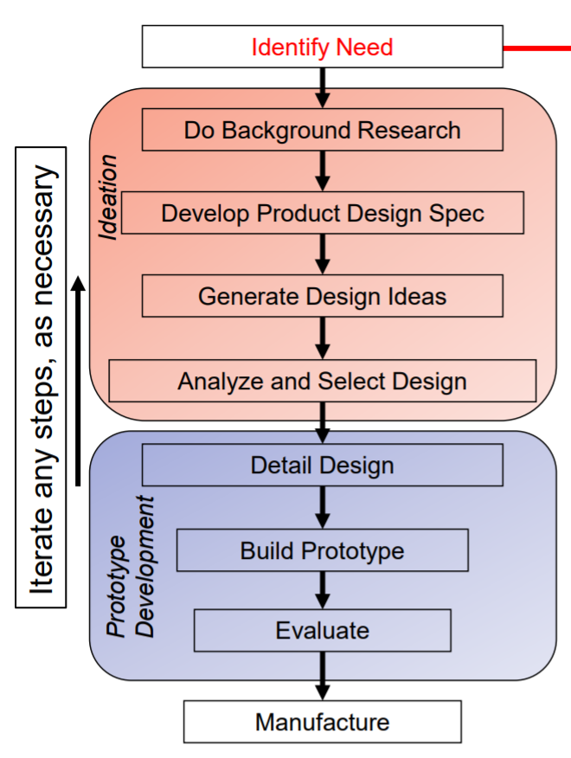
How do we identify needs?

Slide 10
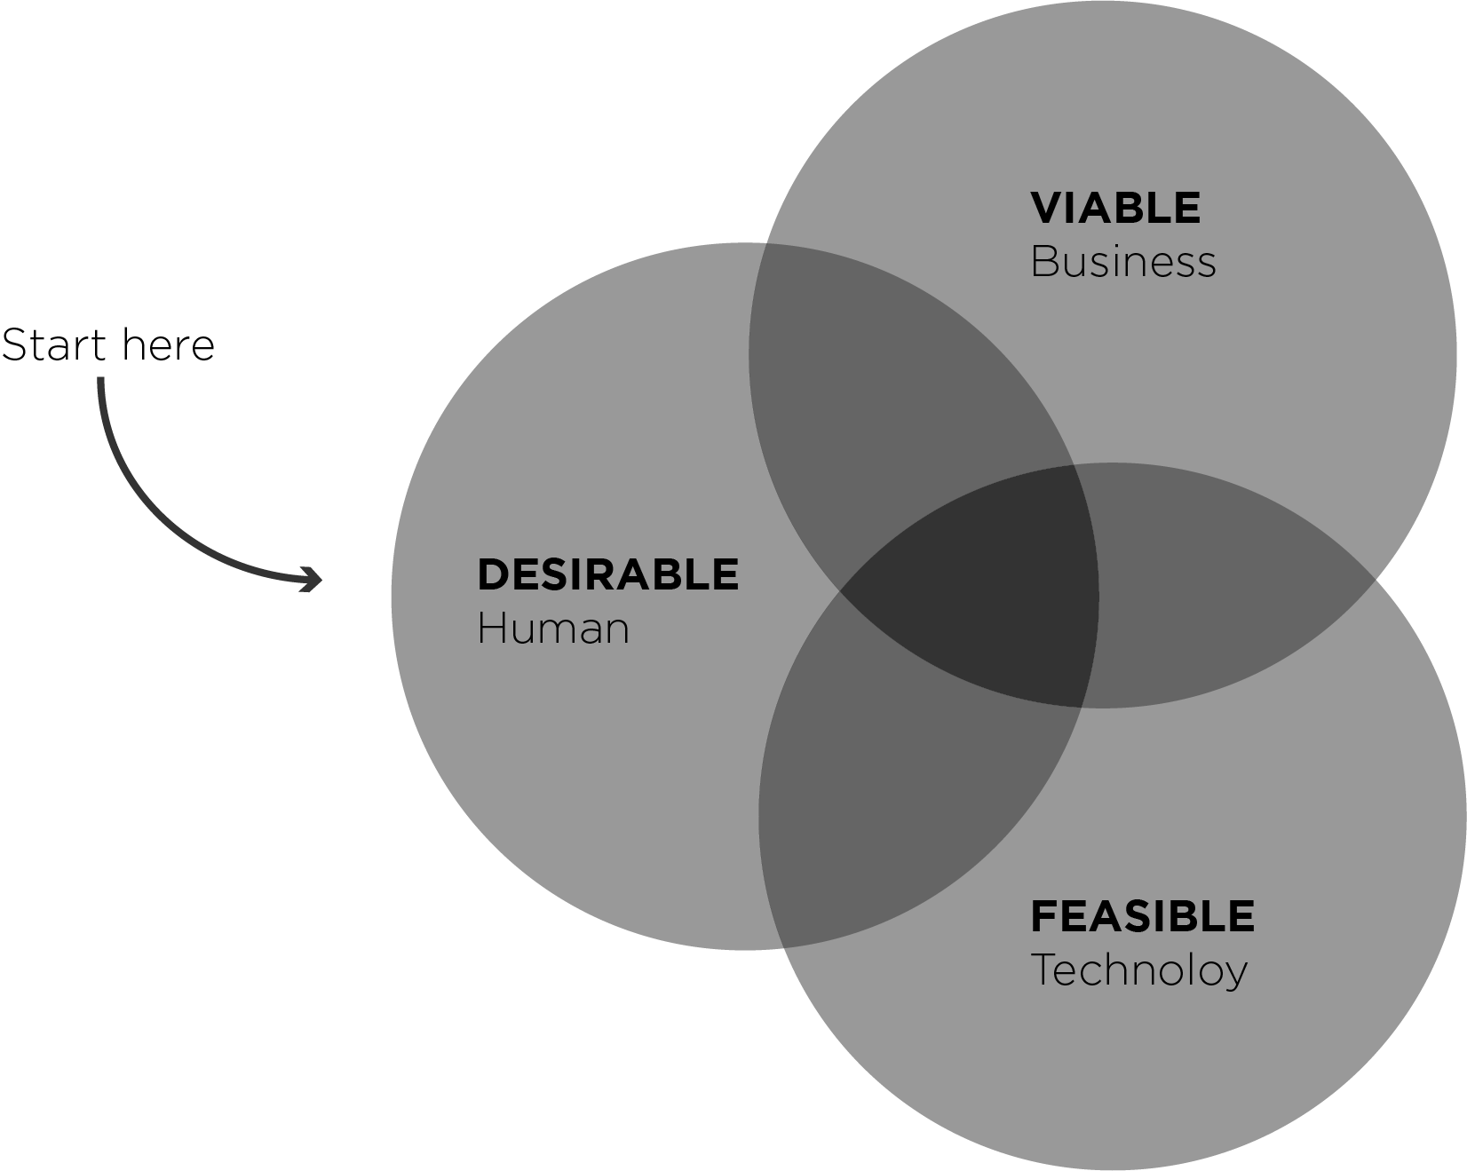
Why Human Centered Design?
Notes:
Human Centered Design (HCD) is an interdisciplinary, problem solving approach that identifies the unmet needs of a population in order to collaboratively develop solutions. Where engineering design ultimately aims to converge to some “optimal” solution, human centered design aims to first expand the view of the problem so the most important and relevant information can be found. By talking to and working with the people who experience the problem from a variety of perspectives, human centered designers work to build a more complete and empathetic understanding of unmet needs. This empathetic view then helps designers make informed design decisions, especially where objective metrics aren’t readily available. By designing in response to the needs of a real stakeholder, human centered design leads to solutions which are impactful and innovative.

Slide 11
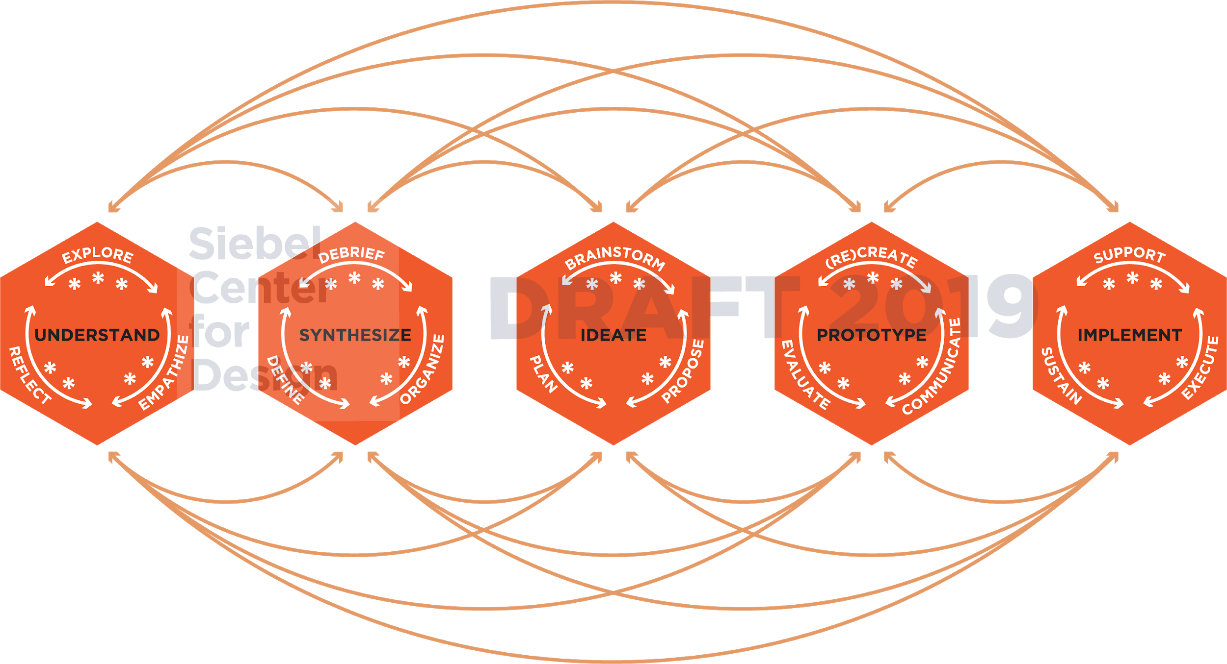

Slide 12
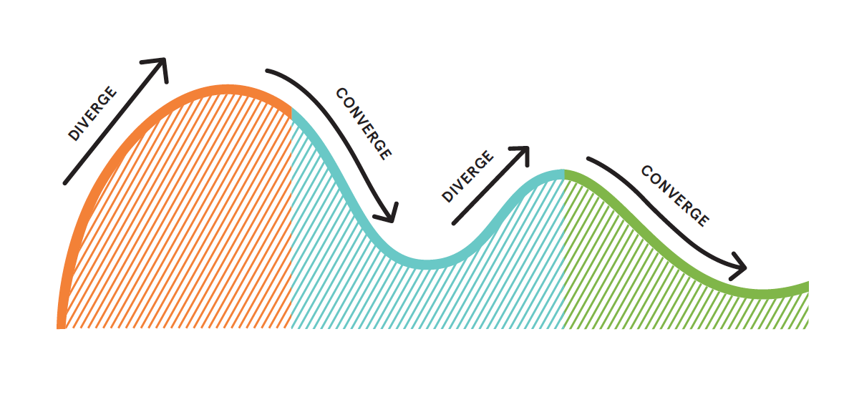
Explore the problem
area
Establish a common problem space
Define the unmet need
Ideate potential solutions
Develop, refine and iterate
*Example does not represent all cases

Slide 13
Design Challenge
I have an electric kettle that I use to heat water to make coffee in the morning, but it gets too hot.

Slide 14
Design Challenge
I have an electric kettle that I use to heat water to make coffee in the morning, but it gets too hot. Can you help me?
Write down your thoughts.
What’s the goal?
How do you define success?

Slide 15
Design Challenge
I have an electric kettle that I use to heat water to make coffee in the morning, but it gets too hot. Can you help me?
What’s the goal? (I want better coffee, more consistently)
How do you define success? (You address my needs and I adopt your design)

Slide 16
How can we achieve success?
If success is defined by the adoption of the new design, it must be desirable, viable and feasible.

Slide 17
Let’s frame this design challenge using a “Point of view” statement.
This is a handy tool which can define the scope of the project and inspire action.
“____User____ needs ____unmet need____ because ____surprising insight____”

Slide 18
Problem Statement/Scope
The electric kettle needs to heat the water less.
vs.
Alex needs a way to make better coffee more consistently because his electric kettle overheats the water.

Slide 19
What else do you need to know?
Alex needs a way to make better coffee more consistently because his electric kettle overheats the water.
LAB 1

Slide 20
What else do you need to know?
What kettle do you use? → What system is in place currently?
How do you use it? → What’s the experience like?
How do you like your coffee? → What’s the target?
…?

Slide 21
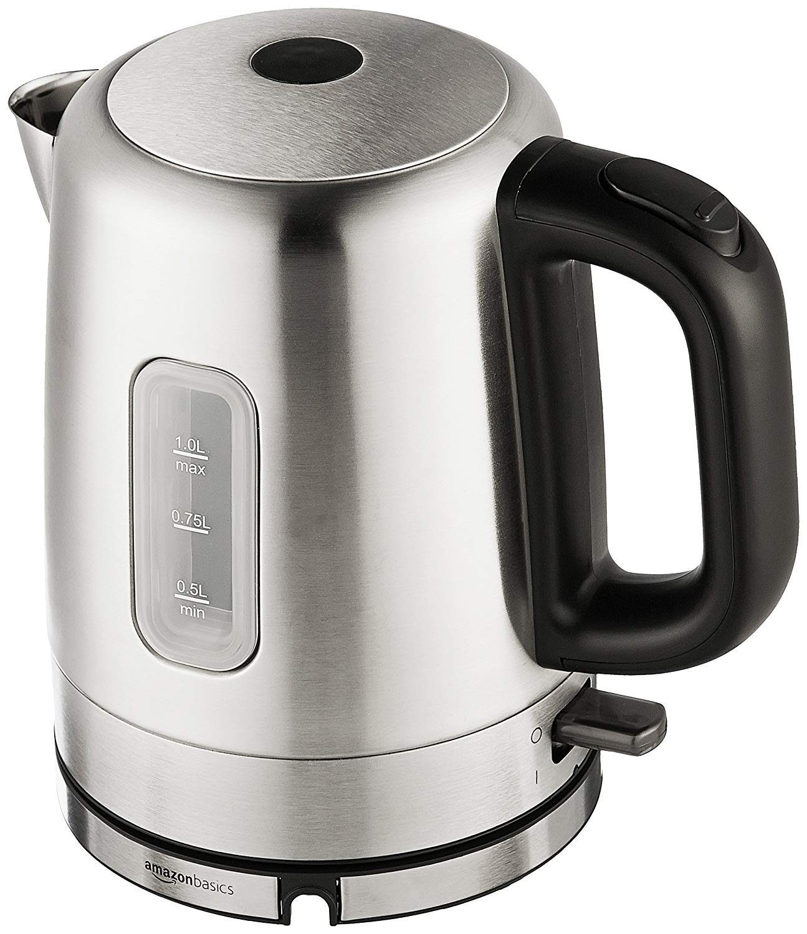
What else do you need to know?
What kettle do you use? → What system is in place currently?
AmazonBasics (link)
How do you use it? → What’s the experience like?
I use a non-contact thermometer and turn it off by hand
How do you like your coffee? → What’s the target?
Cream no sugar, thanks. Aeropress, 2 scoops fresh grounds, water heated <180 F

Slide 22
Revised POV
Alex needs an effortless and consistent way to make high quality coffee because stopping his electric kettle by hand demands too much attention.

Slide 23
How might we...
How might we create better coffee?
How might we make coffee making a more consistent experience?
How might we control the temperature of the water?
How might we minimize effort?
LAB 2
Notes:
The framing of the question and design challenge will drastically alter the solutions that come to mind.

Slide 24
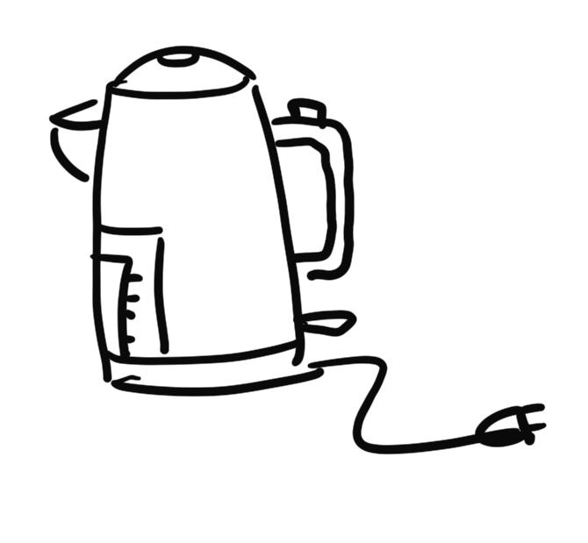
Ideation
Come up with a bunch of ideas that might work to address the HMW questions.

Slide 25
How might we create better coffee?
Cold brew
Optimize variables
Grind
Temp
Ratio
Time
Pressure
Flavor augmentation

Slide 26
How might we control the temperature of the water
Measure temp and control heating (turn off heater)
Measure temp and control heat flux (remove from heat)
Measure temp and control mixing (add cold water)
Measure volume and control heat flux (compute temp)

Slide 27
How might we make coffee making a more consistent experience?
Closed system
Automated
Control algorithms
Post-processing

Slide 28
How might we minimize effort?
Automated system
Timed
Routine activated?
Load once, brew many?
Minimal maintenance
Cleaning
Repair

Slide 29
Develop suitable concepts
And review with users to assess your initial understanding of the problem and to inform design decisions.

Slide 30
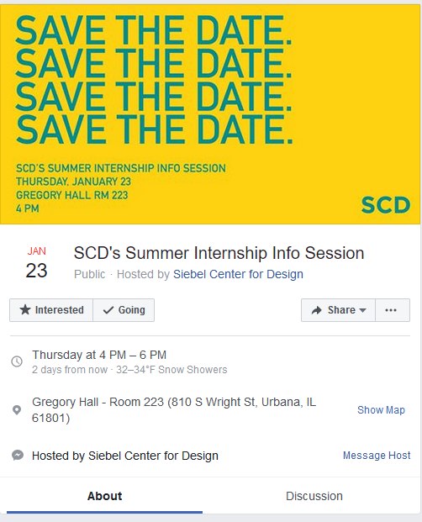
Want more SCD?
Alex Pagano
Senior Design Strategist
apagano2@illinois.edu
Sign up for our newsletter!
@SCDillinois

Slide 31
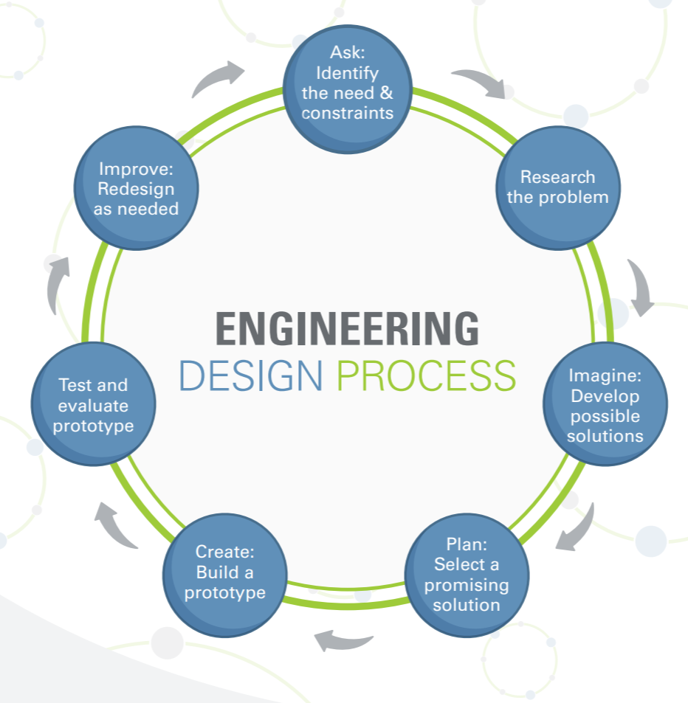

Slide 32
Why Engineers need HCD
Engineers are problem-solvers working to address human needs by:
Increasing efficiency
Increasing productivity
Decreasing costs
Creating new opportunities through innovation
But how do we know what problems are worth solving?
These skills are taught in Engineering courses
Human Centered Design!

